Slide 1
Luke McCubbin
Note generator project

Slide 2
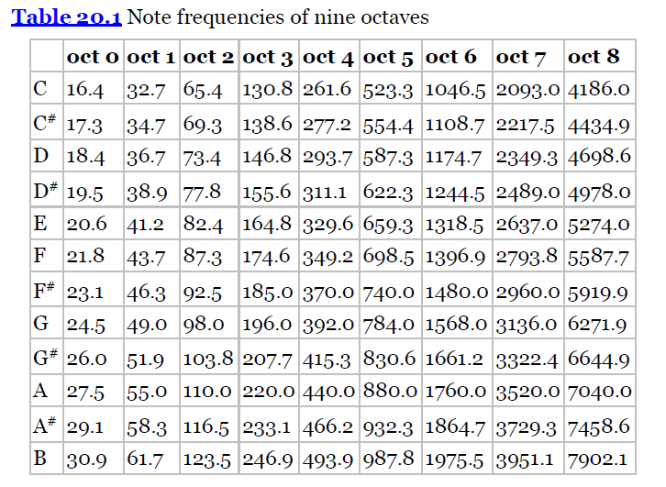
Note Frequencies

Slide 3
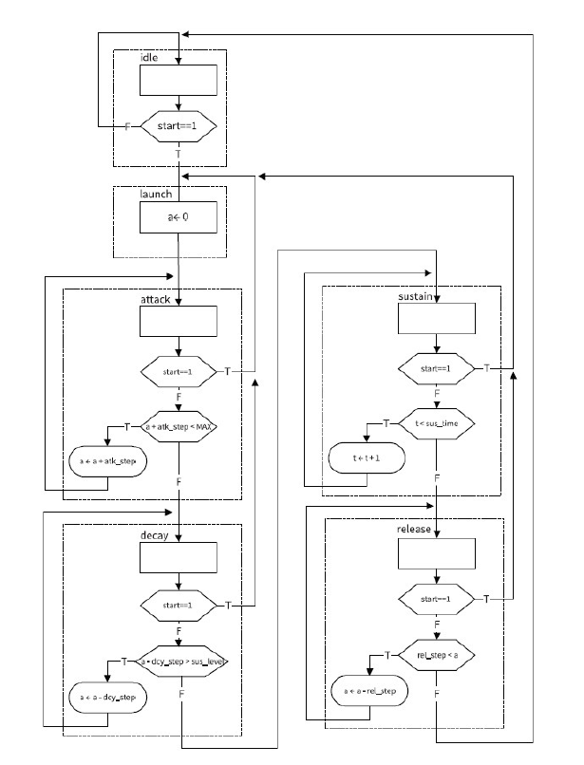
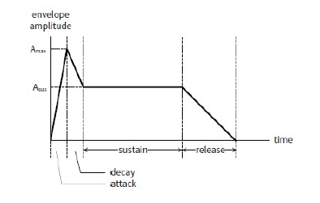
ADSR Module
A = 26ms
D = 130ms
S = 270ms
R = 270ms
Total = 700ms

Slide 4
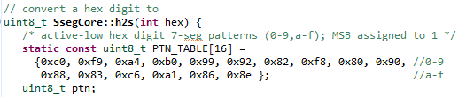
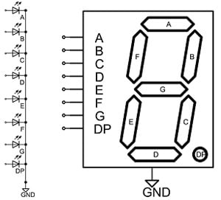
SSEG module
sseg_core.cpp defines a lookup table for values 0-9 and a-f
Displays both octave number and note key

Slide 5
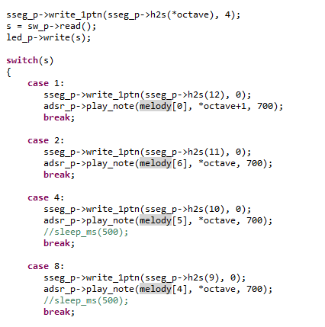
Code
Case statement for each switch that is flipped.
Writes to SSEG
Checks for pushbutton earlier to determine octave
ADSR envelope duration set to 700ms
The ADSR play_note function sets a carrier frequency using DDFS set_carrier_frequency function.

Slide 6
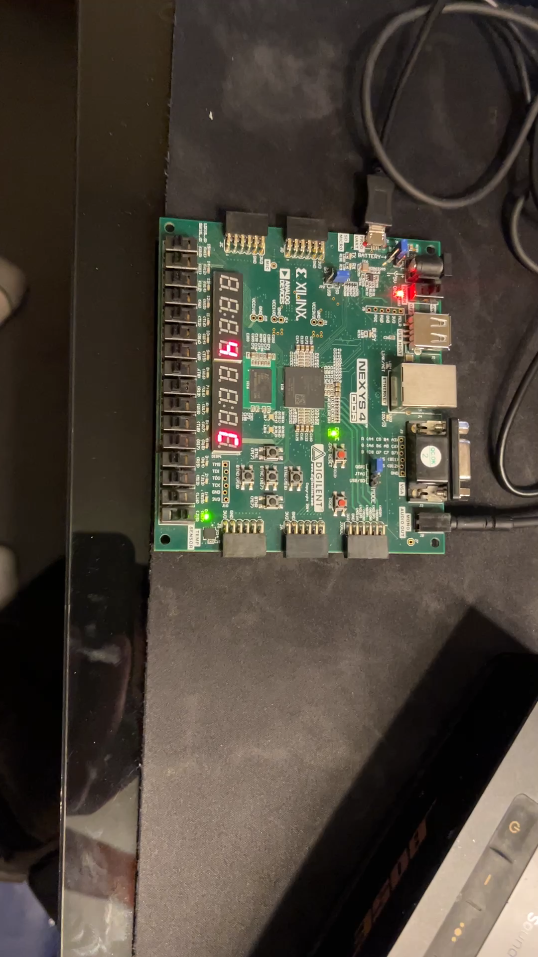
Demonstration

Slide 7
Challenges
Vivado build to vitis integration
download.bit error
Microblaze name error in elif file

Slide 8
Questions?

